Slide 1

Retro Keyboard USB Keyboard Substitute
www.itdiscovery.info/retrokbd
A discussion of systemic issues that set Security Professionals up to fail implementing their program.

Slide 2
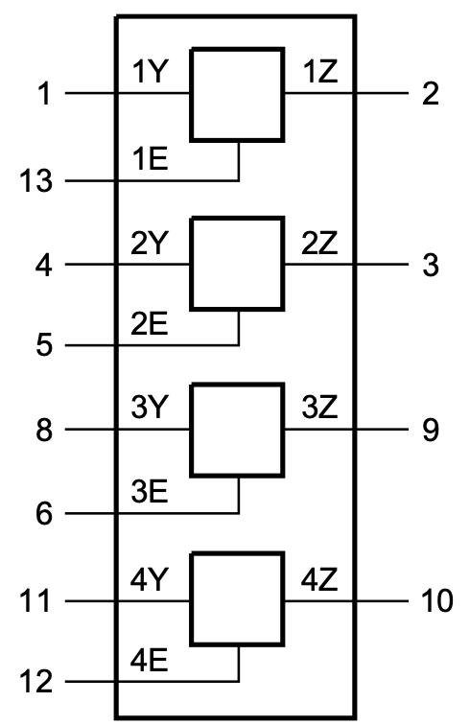
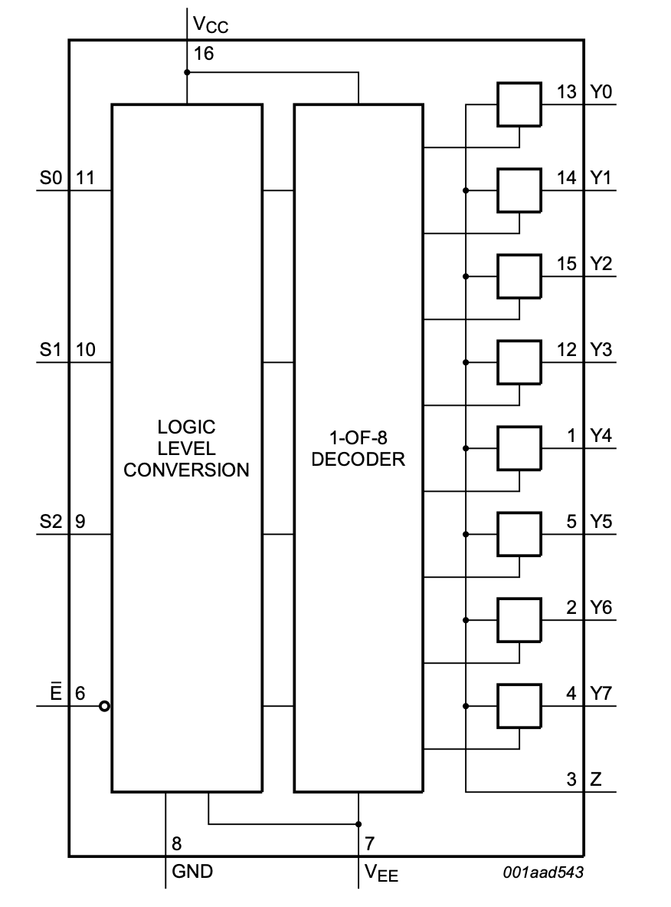
ZX-81 Keyboard
A switch, not a logic high or low.
Single Pole Single Through
74HCT4066
A matrix, not a bunch of switches.
Single Pole 8 Throw (SP8T)
74HCT4051
Data Select to Microcontroller

Slide 3
Reading a USB Keyboard
The connector to mate with USB keyboard is a 4 pin USB Type A
USB Pins to signal to AVR128DB28
1 = +5V, 2 = KBD Clock PIN_PA2, 3 = KBD Data PIN_PA3, 4 = Gnd
#include <PS2KeyAdvanced.h>
Make sure to have attachInterupt=All Pins
keyboard.begin(PIN_PA3,PIN_PA2);
uint16_t c = keyboard.read( );
Ignore Keyboard break and only look at make (one code is received for each)

Slide 4
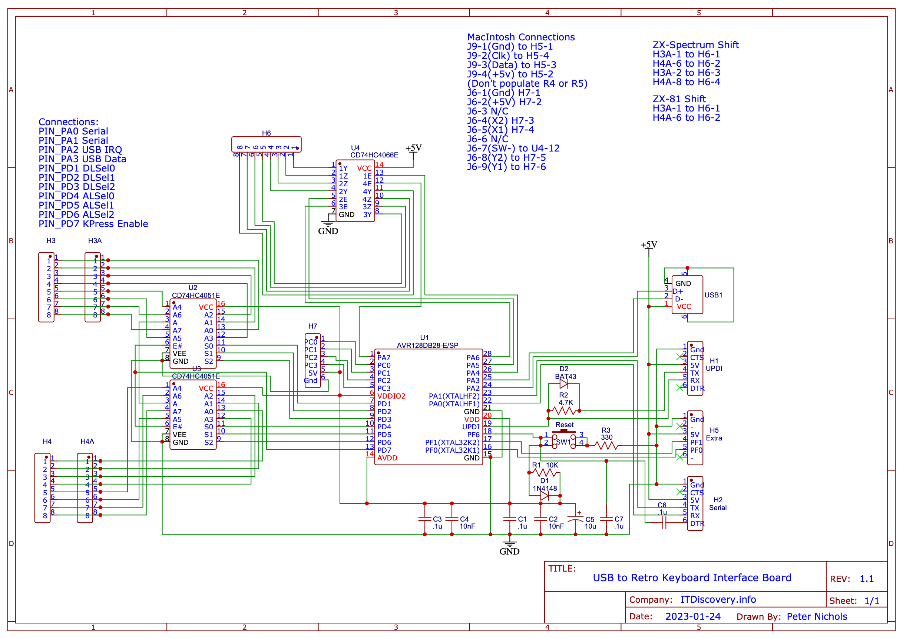

Slide 5
Shift and Ctrl Keys
Shift and Ctrl require two combined keypresses.
Jumper the Shift and Ctrl Keys to from the SP8T to the SPST (H3A/H4A to H6)
Have the AVR command both lines at the same time.
Last step, create a lookup table to convert the USB Keyboard to the binary output on the SP8Ts and SPST.

Slide 6
Mac Classic Keyboard
Keyboard is Serial Out
Mouse is Differential Pair and Switch
Design grabs unused pins on AVR
Keyboard Data = PIN_PF1, Keyboard Clock = PIN_PF0 to RJ-11
Mouse Button = PIN_PD1 (Pin 7 or SW-)
Mouse X2 = PIN_PA4 (Pin 4)
Mouse Y1 = PIN_PA5 (Pin 9)
Mouse X1 = PIN_PA6 (Pin 5)
Mouse Y2 = PIN_PA7 (Pin 8)
Lookup from USB to Mac Classic
Key press via alternate serial out,
Mouse moves out via manipulating PA4-7.

Slide 7
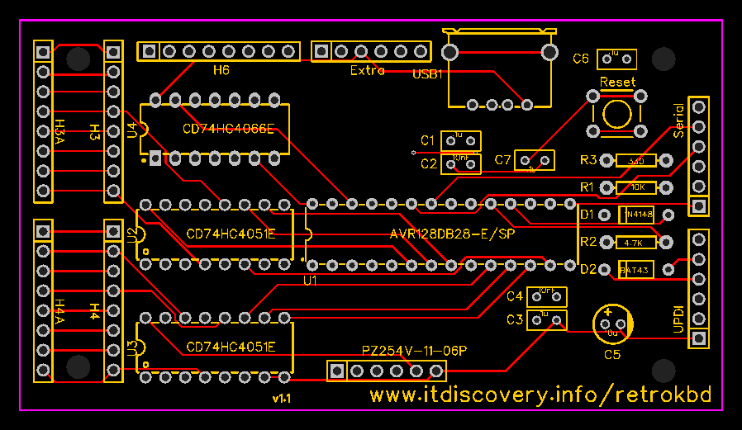
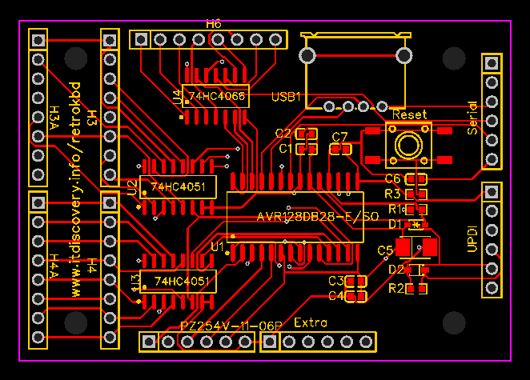
More to Do
Color Computer 1/2/3
Model 1/3/4
Commodore 64/Vic 20
Others?

Slide 8

Questions?

